Slide 2
Welcome to The C.A.R.E. Channel Family!
30 years of C.A.R.E.
Broadcast in over 1000 facilities in every US State and internationally.
Filmed in 30 locations in 11 countries across 6 continents since 2011.
For more information about our staff, including Accounting and Technical Support contacts, please visit healinghealth.com/staff.
Notes:
Future: Group photo of all HHS

Slide 3
C.A.R.E. Can Help With Your Initiatives:
Quiet at Night
Patient Safety
Staff Wellness/Relaxation Rooms
Labor and Delivery Rooms
Patient Experience
Patient Satisfaction
Pain Management
Notes:
Add specific hospital initiatives before giving presentation
Touch on patient experience/satisfaction and pain management

Slide 4
About The C.A.R.E. Channel
Creates a space that supports health and well-being.
Is a good alternative to commercial television.
Lowers stress levels and reduces anxiety with relaxing, calming, and soothing imagery and music.
Helps take patients’ minds off of pain and discomfort by providing a positive distraction.

Slide 5
About The C.A.R.E. Channel
Helps with rest/sleep by supporting the circadian rhythm and assists with masking noisy environments.
Comforts by providing an ongoing therapeutic presence at the bedside when the patient is alone.
Supports family members and loved ones while visiting (in many of the same aspects as listed above).

Slide 6
C.A.R.E. Channel Features
24-hour patient television channel
Your hospital’s channel # =
Up to 84 hours of nonrepetitive programming
At 10 PM, the channel will transition to a beautiful sunset, then into a starfield, to let patients know it’s time for sleep.
At 6 AM, the channel will go from the starfield to a sunrise, signaling to patients it’s time to start their day.
Every year you will receive an annual content update including new scenes as well as editing improvements.

Slide 7
Optimizing The C.A.R.E. Channel
Add "Tune into The C.A.R.E. Channel" as the first step on your room clean checklist.
Turn The C.A.R.E. Channel on in empty rooms.
Use the overnight starfield feature to support Quiet at Night.
Enlist volunteer services.
Utilize C.A.R.E. during and after procedures.
Spread the word.
Set C.A.R.E. as your default channel.
Notes:
Note: The Optimizing C.A.R.E. PDF and What Sets Us Apart PDF can be linked in the resources section

Slide 8
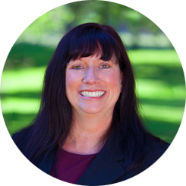
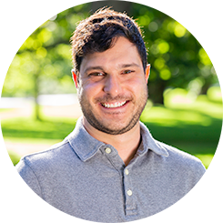
C.A.R.E. Resources
VIDEOS
Pain Management
What Sets C.A.R.E. Apart
UMC & C.A.R.E.
WEB RESOURCES
Client Success Resources and Information
Current Client Contact Form
Brenda Tyler President of Client Success, Co-owner btyler@healinghealth.com 800 348 0799 | 775 499 5592
Adam Carpenter Client Success Specialist acarpenter@healinghealth.com 800 348 0799 | 775 499 5596

